Slide 1
MGT 217
10/29/18

Slide 2
Agenda
Exams: Graded and in Blackboard; will need to review end of next class (Wednesday) due to time
Added 5% to everyone’s grades to account for exam difficulty (won’t happen for Exam #2)
Only 15% of final grade: Lots of opportunities to do well in the class
Case study due Wednesday

Slide 5
Conflict in Teams and Organizations
Conflict is a clash between individuals or groups due to different opinions, thought processes, and perceptions.
Notes:
Teams and organizations face many challenges and it is inevitable that conflicts will naturally arise. We define conflict as a clash between individuals or groups due to different opinions, thought processes, and perceptions. As a member of an organization you will probably have opinions that differ at times from those of other teams or individuals. Sometimes such disagreements and clashes can make us feel uncomfortable. But does this mean all conflict is bad? Not necessarily. There are times when conflict actually helps teams and organizations be more creative and innovative.

Slide 6
Types of Conflict
Conflict in Teams and Organizations
Three main types of conflict:
Task conflict
Relationship conflict
Process conflict
Notes:
The three main types of conflict in organizations are task conflict, relationship conflict, and process conflict.
Task conflict refers to a clash between individuals about the direction, content, or goals of a work assignment. Relationship conflict is the clash in personality between one or more individuals in the workplace. This type of conflict can be useful in resolving disputes if the parties are willing to communicate in a constructive and effective way.
Process conflict refers to the clash in viewpoints about how to carry out work. Like task conflict, process conflict can be beneficial to organizations as long as it operates at a low level.

Slide 7
Emerging View: Constructive Versus Relationship Conflict
Constructive (task-oriented) conflict
  Parties focus on the issue, respect people having other points of view.
  Try to understand logic/assumptions of each position
Relationship (socioemotional) conflict
  Parties focus on personal characteristics (not issues) as the source of conflict.
  Try to undermine each other’s worth/competence.
  Accompanied by strong negative emotions.

Slide 8
Is Conflict Good or Bad?
Negative Outcomes | Positive Outcomes
Wastes time, energy, resources Less information sharing, productivity More organizational politics More job dissatisfaction, turnover, stress Weakens team cohesion (when conflict is within team) | Fuller debate of decision choices Decision assumptions are questioned Potentially generates more creative ideas Improves responsiveness to external environment Increases team cohesion (when conflict outside the team)

Slide 9
How do we resolve conflict?

Slide 10

Negotiation -- conflicting parties attempt to resolve their divergent goals by redefining the terms of their interdependence.
Need to balance collaborative behaviors (create value) and competitive behaviors (claim value)

Slide 11
Negotiation and Dispute Resolution
Negotiation is the process of reaching an agreement that both parties find acceptable.
Notes:
We may not realize it, but most of us negotiate on a daily basis in every aspect of our lives with family members, friends, classmates, roommates and partners, as well as at work with our co-workers, team leaders, and bosses. We define negotiation as the process of reaching an agreement that both parties find acceptable. Since disagreements are common in a range of issues including task allocation, work schedules, and salaries, the art of negotiation is a necessity in life as well as in the workplace.

Slide 12
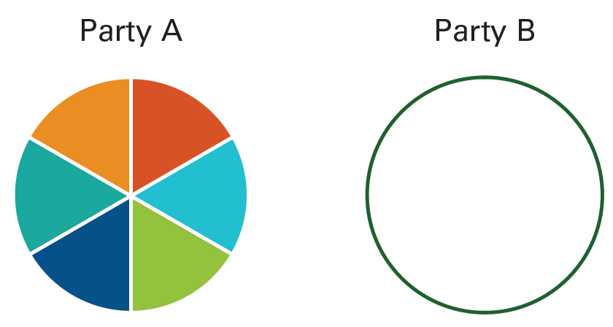
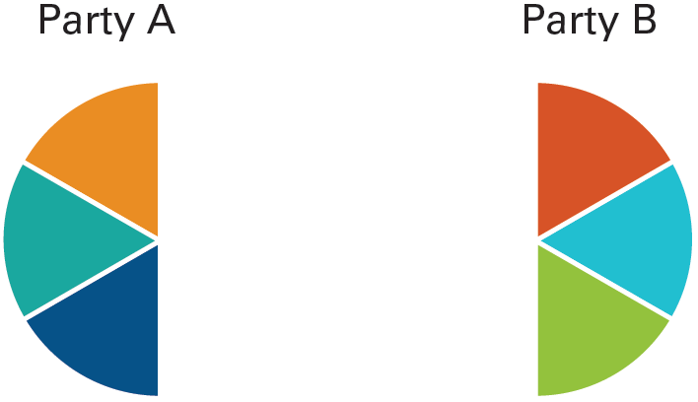
Figure 10.4: Bargaining Approaches
Bargaining Approaches
Distributive Bargaining
Integrative Bargaining
Notes:
The ultimate goal of a negotiation should be to provide an agreement that satisfies everyone and leaves all the parties on good terms. But in reality the process is not always straightforward. The reason is that the way people negotiate has an influence on its outcomes. In general, people use two main bargaining strategies: distributive bargaining and integrative bargaining.

Slide 13
Distributive Bargaining Strategies
Bargaining Approaches
Distributive bargaining occurs when two parties both try to claim a “fixed pie” of resources.
Notes:
Distributive bargaining occurs when two parties both try to claim a “fixed pie” of resources. For example, say you are trying to buy a used car. You know you will need a certain amount of money to fix the car up the way you want it, and for that reason you want a reduction in the price. However, the car salesperson wants the maximum price he can get for the car and tells you to take it or leave it. This is known as a win/lose situation, in which one party only gains and the other one only loses.
Another approach to distributive bargaining is to compromise just for the sake of ending the negotiation. For example, say you and the car salesperson have been haggling for a long time and each of you is getting frustrated. The rep agrees to let you have a small percentage off the price, but you do not feel it is enough. Eventually you both give up something in order to agree on a price, but neither of you is satisfied with the outcome. In many instances distributive bargaining can be time-consuming and inefficient. It can lead to a contest of wills, especially when egos get in the way. It is better suited to short-term bargaining with people you are unlikely to deal with again than to the building of long-term relationships, which require a degree of give and take.

Slide 14
Integrative Bargaining Strategies
Bargaining Approaches
Integrative bargaining occurs when both parties negotiate a win-win solution.
Notes:
Integrative bargaining occurs when both parties negotiate a win-win solution.²² It is about enlarging the pie so everyone gets a piece. This type of bargaining applies to businesses that want to build long-term relationships with each other. For example, a clothing manufacturer is looking to negotiate with its fabric supplier to reach a mutually beneficial agreement. The manufacturer wants the supplier to consistently provide it with high-quality fabrics at a fair price within the allotted timeframes. The fabric supplier agrees and a formal contract is arranged. In the end, both parties win: the clothing manufacturer has negotiated a long-term contract with the fabric supplier at a fair price, and the fabric supplier is guaranteed a stream of business from the clothing manufacturer. Both parties have achieved the maximum value from the negotiation.

Slide 15
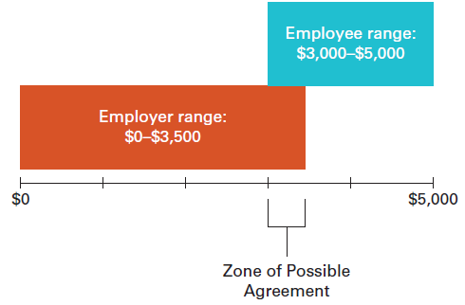
Other Negotiating Strategies
Bargaining Approaches
Figure 10.5: Zone of Possible Agreement
Notes:
It is always wise to have a best possible alternative to a negotiable agreement (BATNA), which is the best outcome you could achieve if the negotiation fails and you must follow another course of action.²⁵ For example, say you want a salary raise of $5,000 per year, but you will accept $3,000 if it is offered. What will you do if you are unable to get the $3,000 raise? Will you settle for your current salary? Will you quit your job and try to find a higher paying job in another organization? Once you have identified your BATNA, you will be in a better position to figure out your zone of possible agreement (ZOPA) which is the area where two sides in a negotiation may find common ground²⁶ For example, say you request your $5,000 salary raise and your boss tells you that the best offer will be $3,500. Since this figure lies within the zone that both parties find acceptable, then it is likely an agreement will be reached.

Slide 16
Bargaining Zone Model
Your Positions
Initial
Target
Resistance
Area of
Potential
Agreement
Resistance
Target
Initial
Opponent’s Positions

Slide 17
UGLI ORANGE

Slide 18
I am Dr. Cardoza, the owner of the remaining Ugli oranges. After you read about your roles, spend about 6 to 10 minutes meeting with the other firm's representative and decide on a course of action. I am strictly interested in making a profit and will sell my oranges to the highest bidder. Since my country is alien to yours, there is no way either government will assist you in obtaining the oranges from me. Each pair of negotiators can assume that there are no others interested in the oranges.

Slide 19
Ugli Orange
When you have reached a decision, pick a spokesperson who will tell me:
1. What do you plan to do?
2. If you want to buy the oranges, what price will you offer?
3. To whom and how will the oranges be delivered?

Slide 20
Ugli Orange
Was there full disclosure? What information was shared?
Did you trust each other?
Would you work with each other again?

Slide 21
Strategies for Claiming Value
Claiming value – aiming for the best possible outcomes for yourself and your constituents.
Prepare and set goals
Know your BATNA (Best Alternative to a Negotiated Agreement)
  cost of ending negotiation; best outcome through another means
Manage time
  avoid time pressure; avoid escalation of commitment
Manage first offers and concessions

Slide 22

Strategies for Creating Value
Creating value – use problem solving to help both parties reach the best outcomes.
Gather information
  Understand other party’s
  needs/expectations
Discover priorities through offers
and concessions
  Make multi-issue proposals
Build the relationship
  Emphasize common backgrounds,
  manage first impressions, maintain
  positive emotions, act reliably
10-22

Slide 23
Conflict Handling Contingencies
Problem solving
  Best when:
    Interests are not perfectly opposing
    Parties have trust/openness
    Issues are complex
  Problem: other party may use information to its advantage
Forcing
  Best when:
    you have a deep conviction about your position
    quick resolution required
    other party would take advantage of cooperation
  Problems: relationship conflict, long-term relations

Slide 24
Conflict Handling Contingencies
Avoiding
  Best when:
    conflict is emotionally-charged (relationship conflict)
    conflict resolution cost is higher than benefits
  Problems: doesn’t resolve conflict; causes frustration
Yielding
  Best when:
    other party has much more power
    issue is much less important to you than other party
    value/logic of your position is imperfect
  Problems: increases other’s expectations; imperfect solution

Slide 25
Conflict Handling Contingencies
Compromising
  Best when:
    Parties have equal power
    Quick solution is required
    Parties lack trust/openness
  Problem: Sub-optimal solution where mutual gains are possible

Slide 26
Five Conflict Handling Styles
High
Assertiveness
Low
Cooperativeness
High

Slide 27
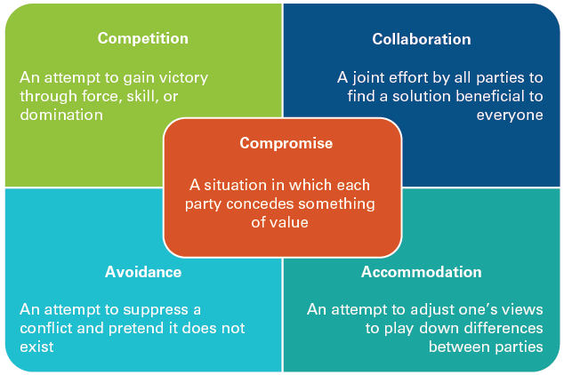
Figure 10.1: Conflict Management Strategies
Forcing/
Problem Solving/
Yielding/
Notes:
Conflict is inevitable in the workplace. If you understand the five basic conflict-management strategies, you will be able to manage conflicts so they are productive and do not escalate out of control. The five strategies are: avoidance, accommodation, competition, compromise, and collaboration.

